Slide 1
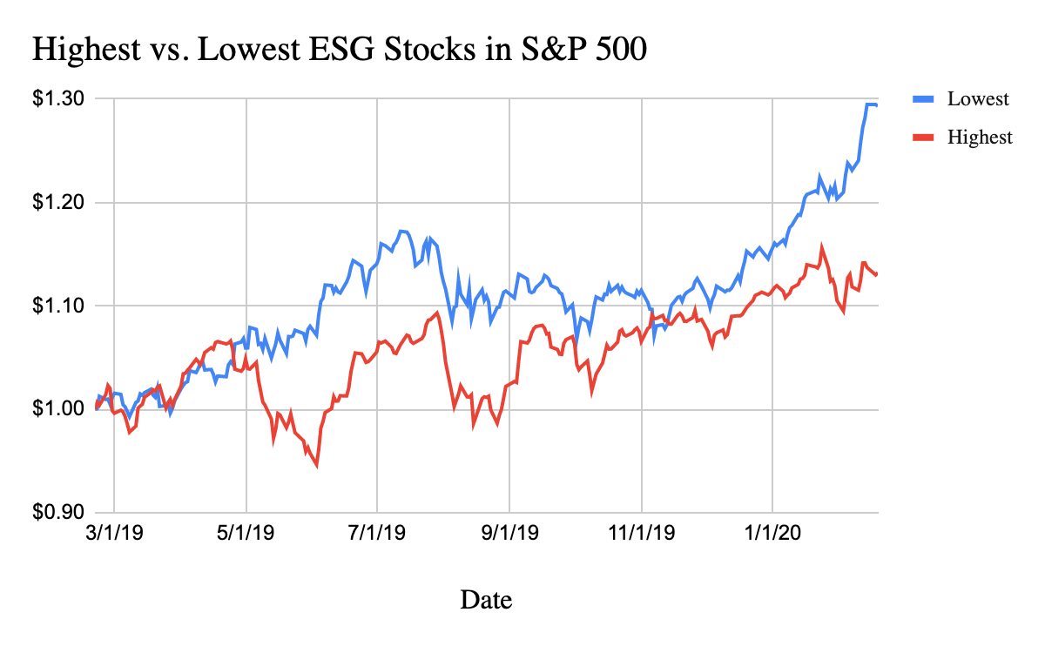
Central Question
Is there a risk premium associated with “ESG” stocks.

Slide 2
Methodology
We will be matching ESG scores (0-100) to each stock in the S&P 500. These scores have been sourced from Sustainalytics.
Next, we will be assigning different weights to each stock in the portfolio based on their ESG score.
Then we will analyze what characteristics and metrics of the portfolio changed. For example, return, beta, Sharpe Ratio and industry exposure.
If we have extra time we will apply modify this process to the whole universe of ESG rated stocks.

